Slide 1
Fundraising as a central committee
Miranda Marquit, Chair, Bonneville County Democratic Central Committee

Slide 2
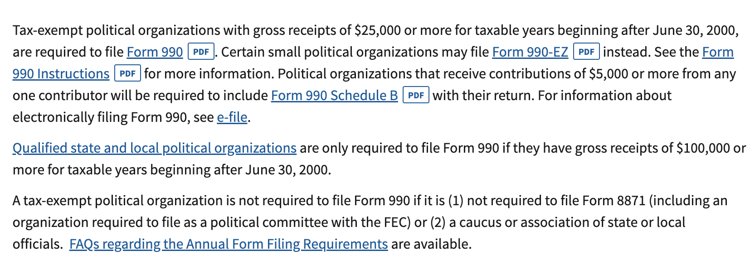
Getting an EIN
Go to: https://www.irs.gov/businesses/small-businesses-self-employed/apply-for-an-employer-identification-number-ein-online.
You can apply online between 7 am and 10 pm Eastern time. It only takes a few minutes.
Remember: You’re a 501(c)4. You’re a nonprofit but a political organization. Donations to you ARE NOT tax-deductible for the donor.

Slide 3
Setting up your bank account
Once you have your EIN, open an account. We opened a business account under the full name of our committee: Bonneville County Democratic Central Committee.
Depending on the situation, you might need two signatures for checks. Consider having at least three signatories for the account. We use:
  Treasurer
  Chair
  Vice-Chair
  Secretary
Some banks require a board action. Make sure your minutes show that you have designated certain people as signatories.
We order debit cards (we have two) so we can make online purchases and easily go to the store, without two people signing checks.
Legislative Districts can follow this approach as well.

Slide 4
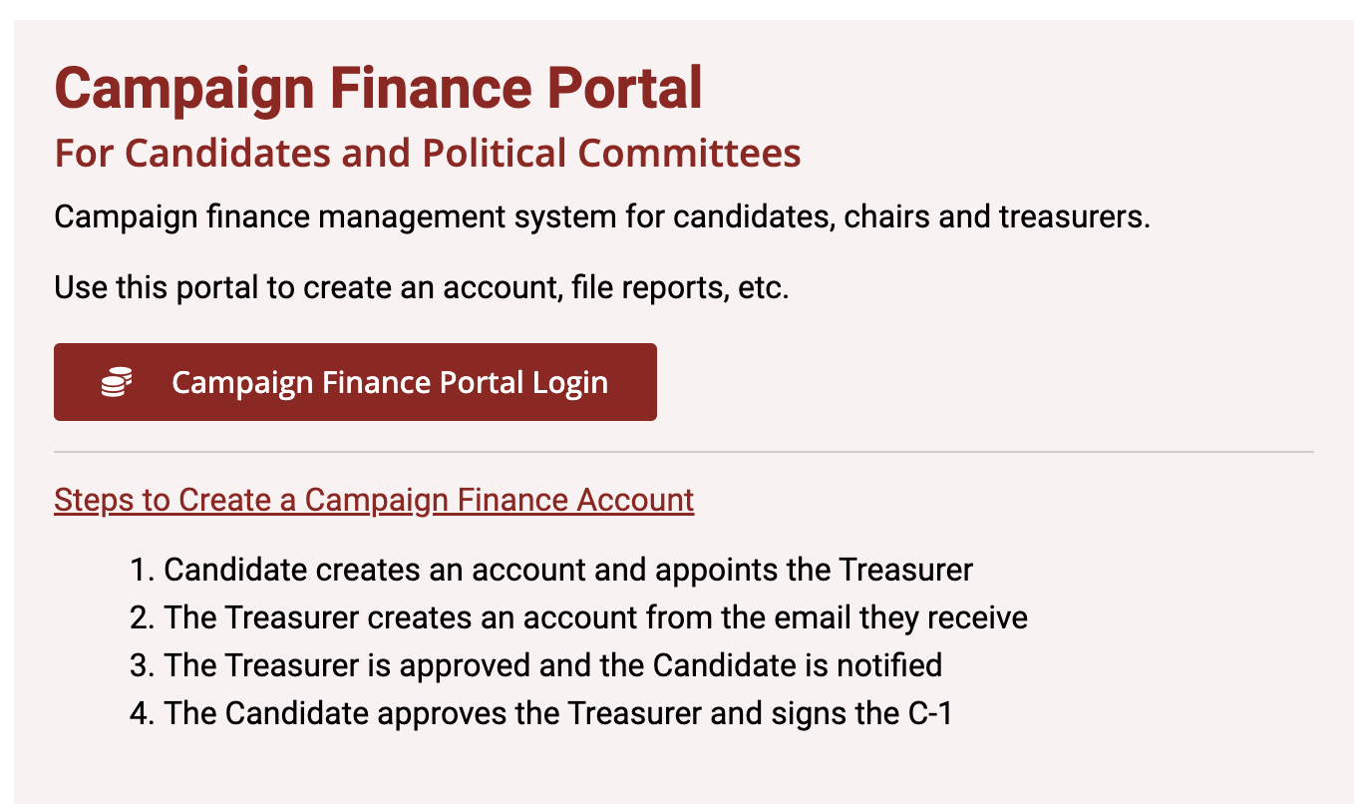
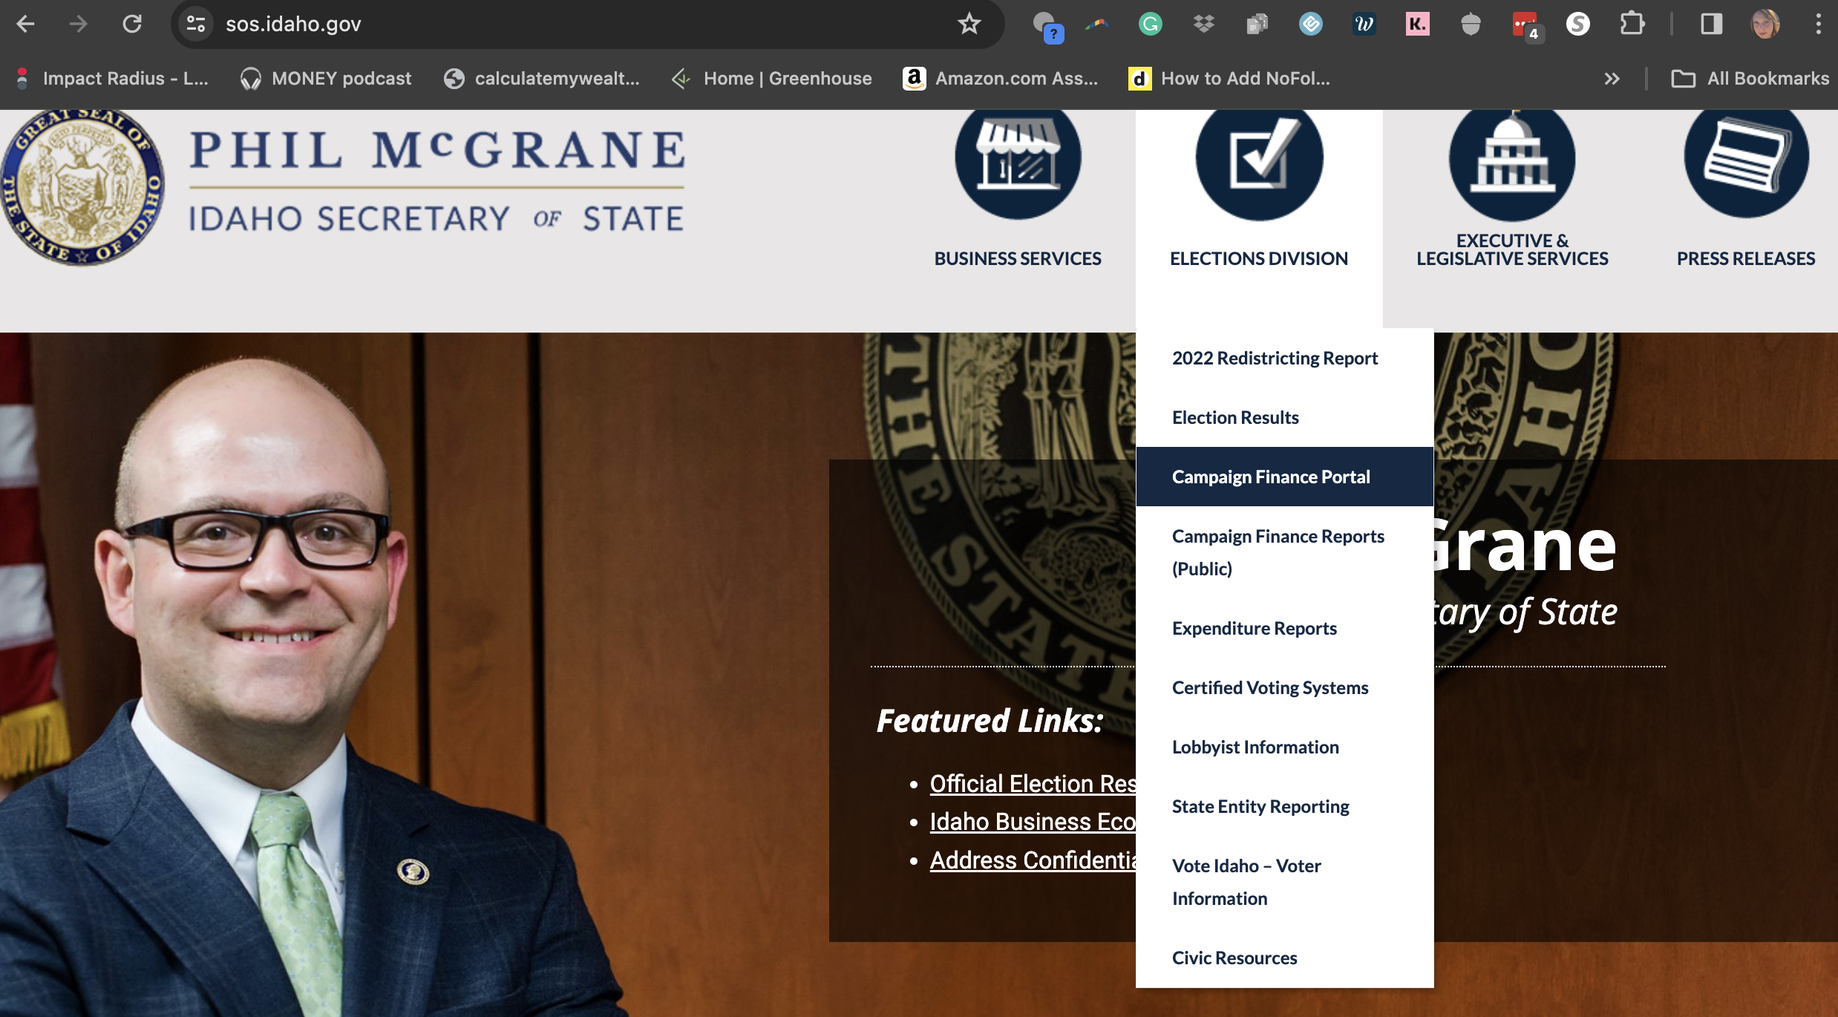
Reporting
You need to appoint a Treasurer
Reports submitted online each month
  48 hours to report amounts of $1,000 or more, receiving or spending
Go to sos.Idaho.gov to sign up for an account and submit reports

Slide 5
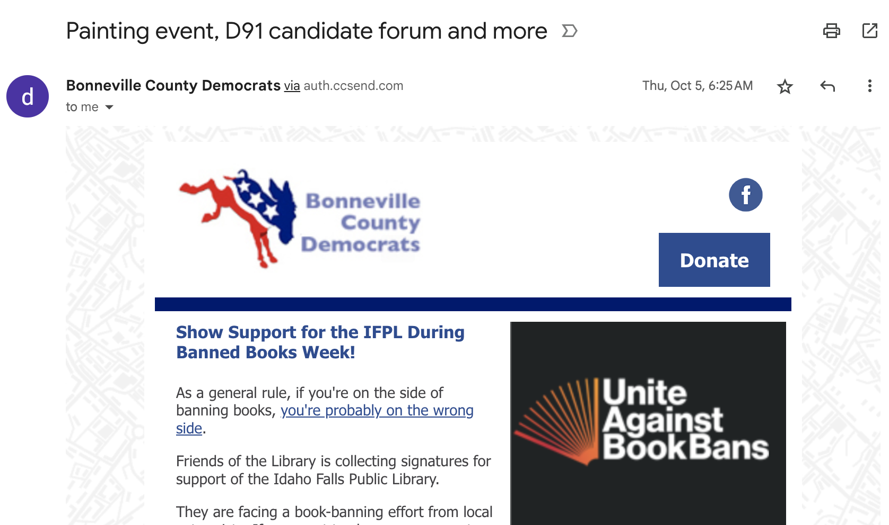
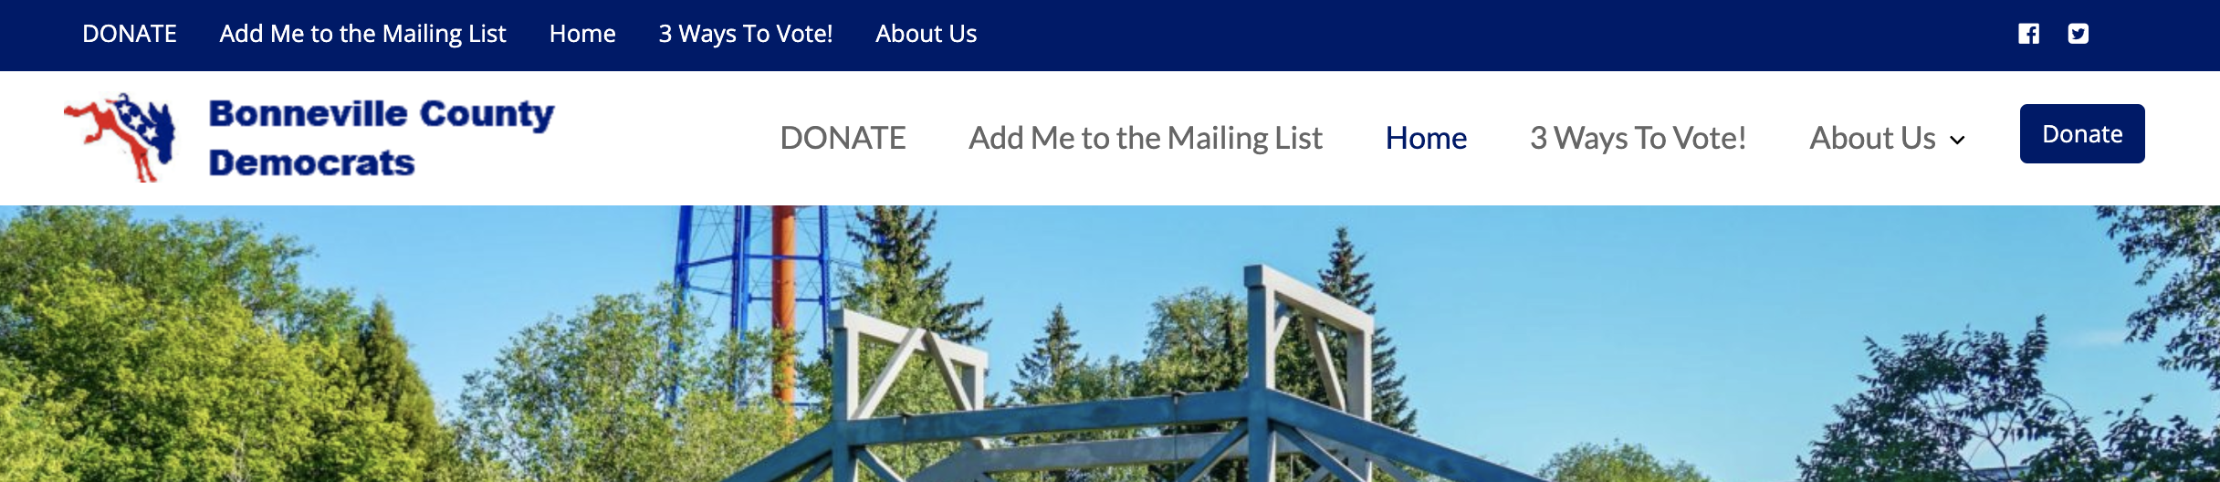
Get that green
When accepting donations, you generally need a full name and an address.
Technically, cash donations of less than $50 don’t need to be reported on the Sunshine Report. However, there’s supposed to be a running total. We fudge a bit by setting out the cash jar to collect donations.
Checks are easy because they usually include an address.
Consider using Act Blue to accept donations online. They automatically collect the information you need for a Sunshine Report. We have buttons on our website and in our newsletter, designed to take donors straight to our Act Blue form. The fee they charge is worth it. [screenshot website and newsletter buttons]

Slide 6
Get that green
Make it easy to accept payment by accepting Venmo. This can be tricky, since you need name and address.
  If you know the people, and they’ve donated before, you probably have a record.
  I sometimes use Votebuilder to look up addresses if needed.
  Ask donors to include their name and address in the “notes” section when they use Venmo
We also have a Stripe account. Stripe or Square can allow you to accept credit card payments. Once you again, you don’t always have access to address information.
  You need to download an app for your phone. New phones can accept “tap” payments, but there’s also manual entry. They usually send at least one swiper you can use with your phone.
  As with Act Blue, there will be a fee. It’s worth it to accept credit cards, though, especially in an increasingly cashless society.

Slide 7
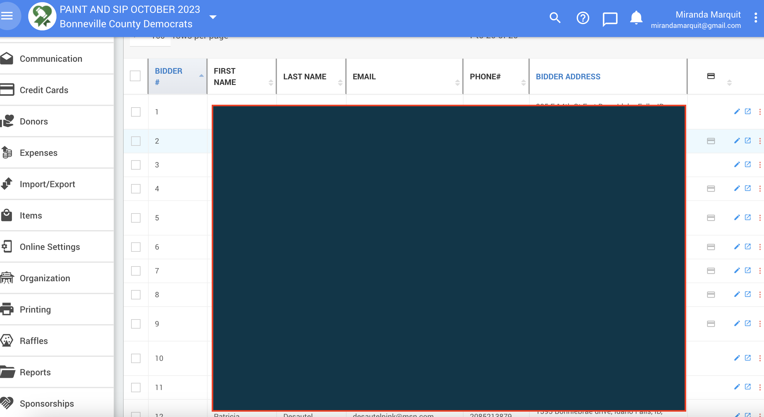
Get that green
We use Auctria for our event management.
  Event website
  Ticketing
  Auction items, dessert dash, raffle, etc.
  Email communication
Connects to your Stripe account.
Set it to collect addresses when people buy a ticket so you have your record.
Allows people to keep adding to their “tab” throughout the event.
Automatically charges the card if one has been saved (encouraged).

Slide 8
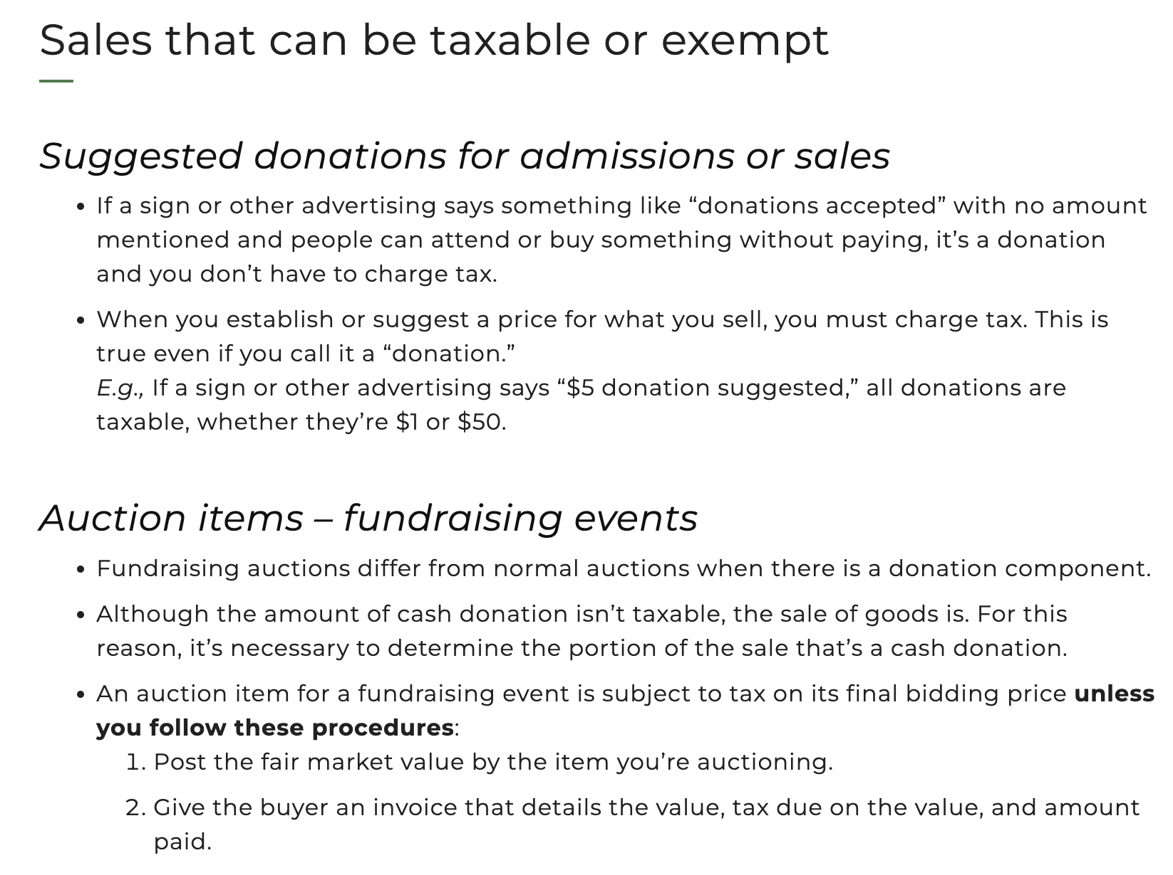
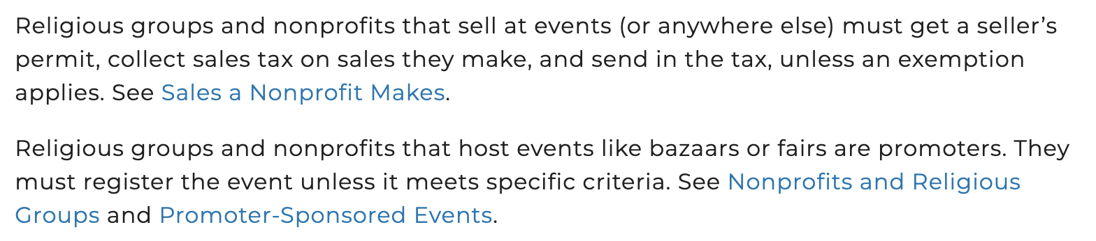
Selling items
We often simply ask for a donation.
Many events require vendors to get a temporary sellers permit if they plan to sell items; you may have to provide a form affirming you aren’t selling anything.

Slide 9
Fundraising ideas
Every newsletter and email you send should have a donate button. You don’t have to ask all the time, but the button should be visible wherever you can put it, including your website and social when applicable.
Have a donation jar at every event. Stick your Venmo QR code on the jar.
Sell items or offer them for a suggested donation. Stickers and temporary tattoos are hot right now. They are relatively inexpensive. I use Canva or Sticker Mule for our stickers. There are also generic stickers available cheaply on Amazon.
Consider different activities. We recently had a paint night with a local artist donating her time to teach. We’re looking at a political trivia night, and interest meetups. We also have our pizza & politics events. We have a summer picnic and sit at various booths.
Our galas have found increased success by:
  Dessert dash instead of dessert auction
  Getting rid of the silent auction in favor of a raffle (people love the wingspan option)

Slide 10
Questions?
mirandamarquit@gmail.com

